Slide 1






INVENTORY MANAGEMENT
HARSHA S
Ashwini Belkeri
Gautam Sharma
Swathi S H
Adari Ganeswara Sai Sreeram

Slide 2
PROBLEM STATEMENT
Businesses face risks of stockouts and overstocks.
Both lead to losses: missed sales or excess holding costs.
Goal: Predict inventory risk category before it impacts business.

Slide 3
DATASET OVERVIEW
Source: Stock risk prediction dataset (Excel format)
Target variable: stock_status (Stockout or Overstock)
Initial Rows: 5000+ with 11 columns
Categorical features: season, item_category
Numerical features include stock and demand metrics

Slide 4
DATA PREPROCESSING
Dropped null values
Mapped stock_status: Stockout = 1, Overstock = 0
Converted forecast_error to absolute values
One-hot encoded season and item_category
Selected top 7 features using Random Forest importance

Slide 5
FEATURE SELECTION
Top 7 features:
current_stock
reorder_point
avg_daily_demand
sales_last_30_days
stock_turnover_ratio
lead_time_days
forecast_error
Based on high predictive value

Slide 6
DATA IMBALANCE HANDLING
Problem:
Solution:
More "overstock" than "stockout" labels
Applied SMOTE (Synthetic Minority Over-sampling Technique)
Balanced training dataset before ANN model training

Slide 7
MODEL ARCHITECTURE
Layers:
Model:
Input: 7 features
Dense(32, relu)
Dense(16, relu)
Dense(1, sigmoid)
Loss: Binary Crossentropy
Optimizer: Adam
Artificial Neural Network (ANN)

Slide 8
MODEL TRAINING & EVALUATION
Epochs: 100 with EarlyStopping
Validation split: 20%
Metrics: Accuracy, Classification Report
Results: High accuracy and balanced F1-score

Slide 9
DEPLOYMENT WITH STREAMLIT
User-friendly web interface using Streamlit
Users input 7 features manually
Model returns prediction: Stockout / Overstock
Display of probability score included

Slide 10
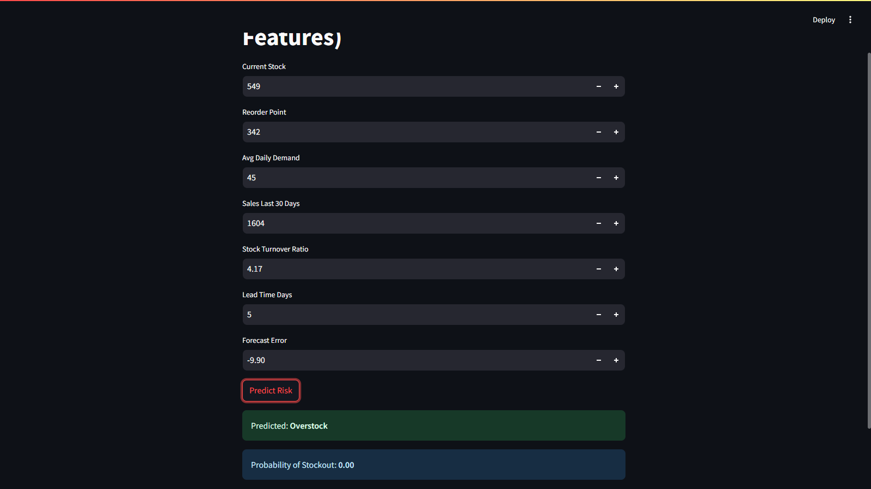

Slide 11
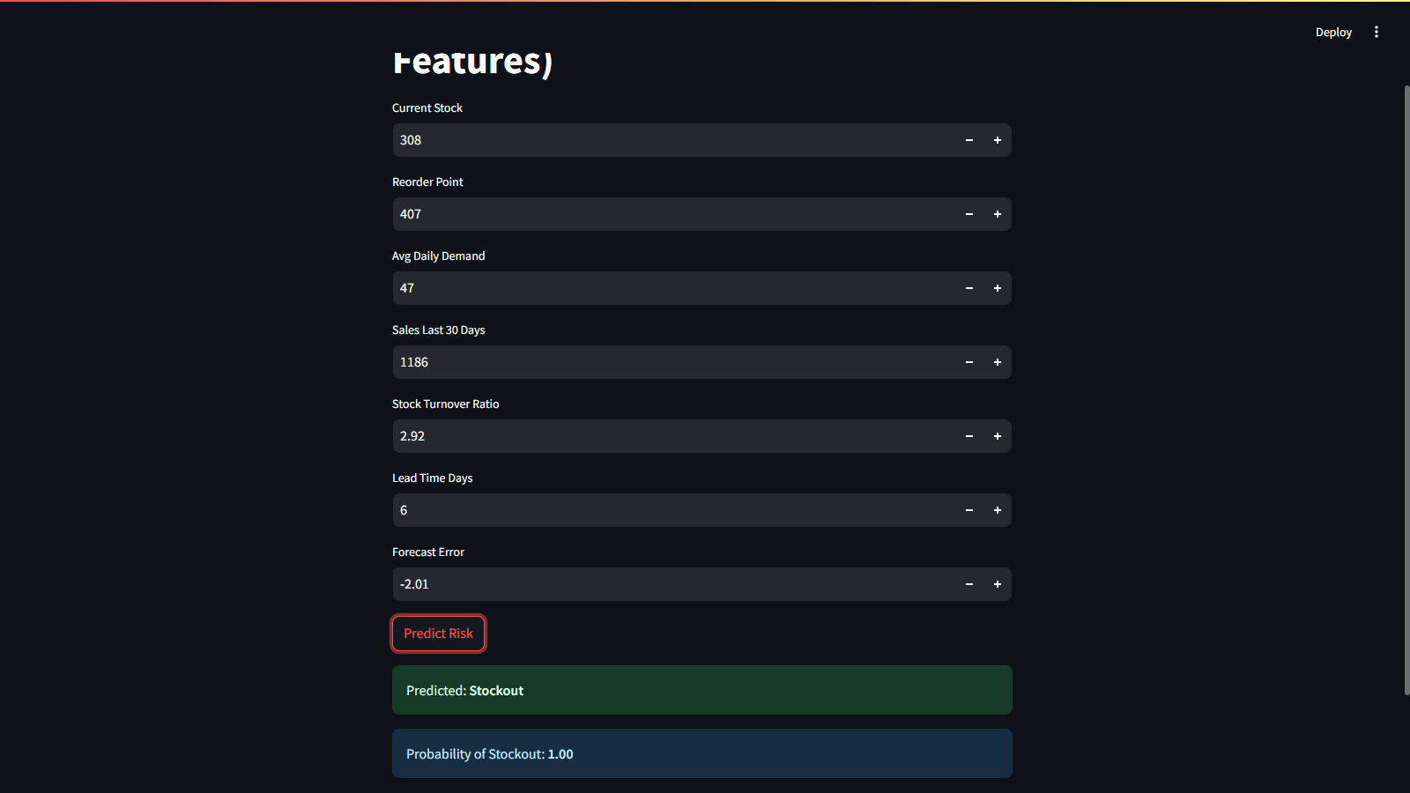

Slide 12
CHALLENGES & FIXES
Model overfitting initially → fixed with SMOTE + EarlyStopping
Handled data scaling, feature mismatch warnings

Slide 13
CONCLUSION & FUTURE WORK
ANN model successfully predicts inventory risk
High accuracy, responsive web UI
Future Scope:
Automate data collection
Include time-series analysis
Test across different industries

Slide 14
THANK
YOU

